Slide 1

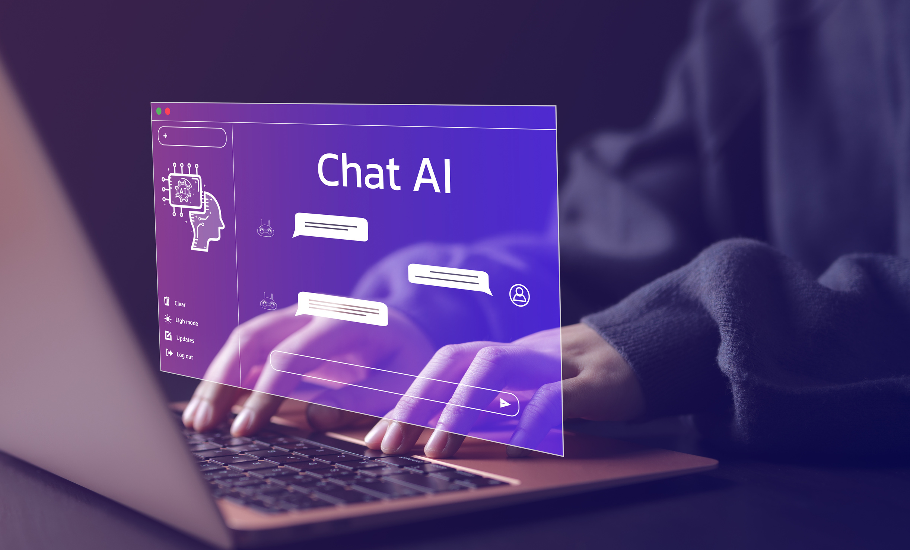



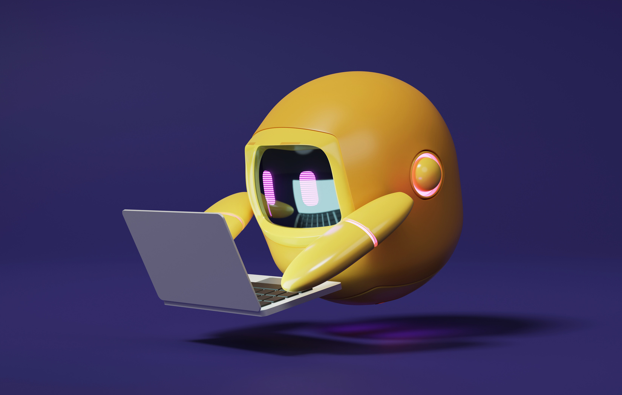


A 2-DAYS NATIONAL LEVEL HACKATHON
AI IN EDUCATION
NeuroAdaptive Learning
Team name: Binary eclipse
Team Members:
Karan Rathore, Mahendra Parmar
Team Lead: Harshit Dubey
www.samadhan.sistec.ac.in/

Slide 2


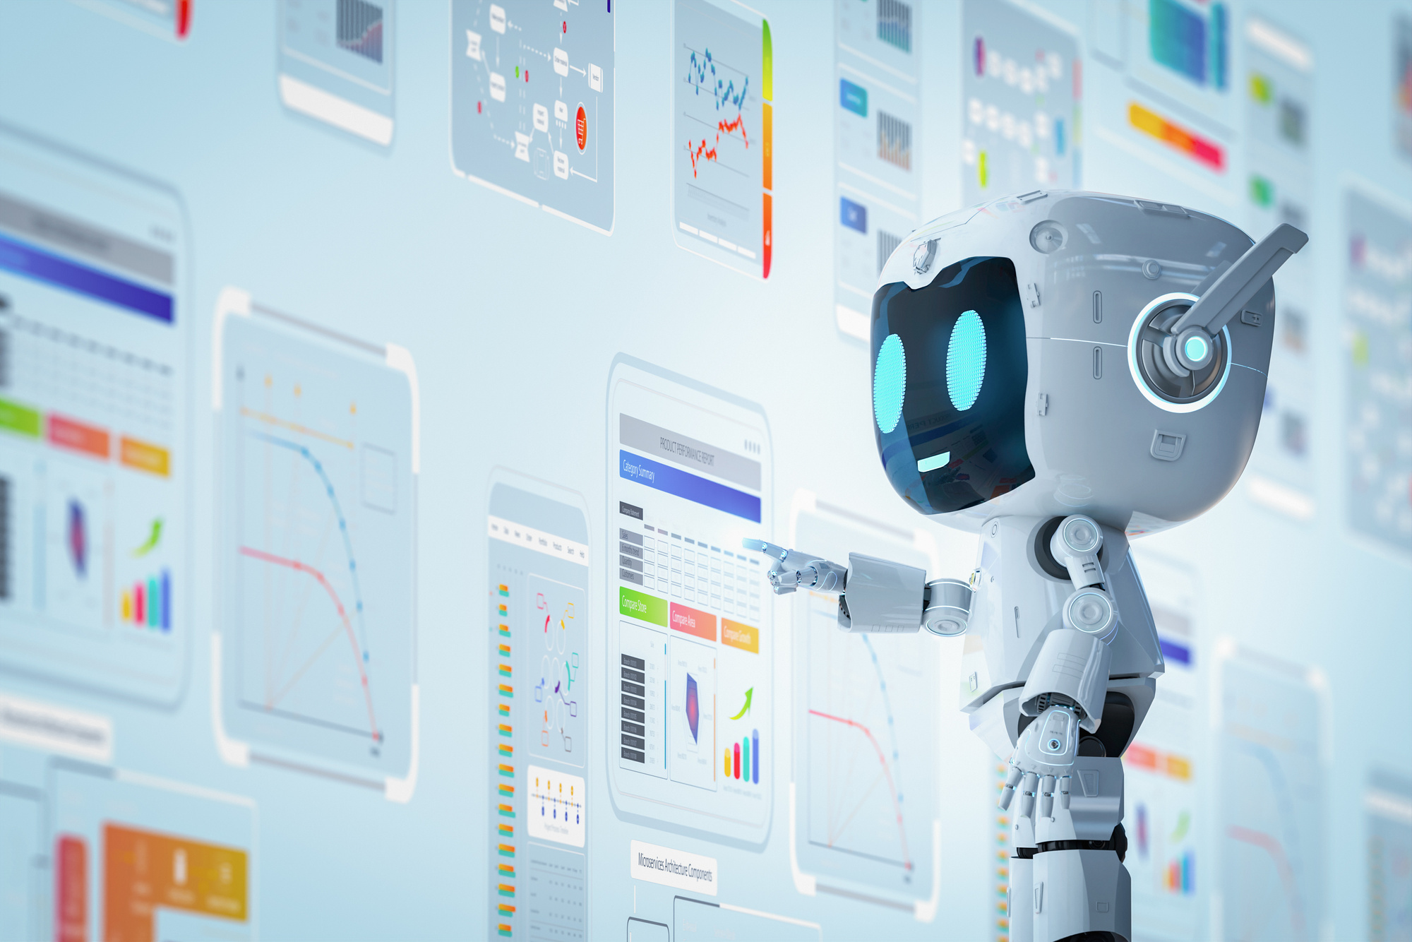

The Problem
Traditional education = one-size-fits-all
Learners have different speeds, styles,
and emotional responses.
Current ed-tech personalization is basic.
(only difficulty adjustment, not real-time).
Neurodivergent learners (ADHD, dyslexia, autism)
are often left behind.

Slide 3
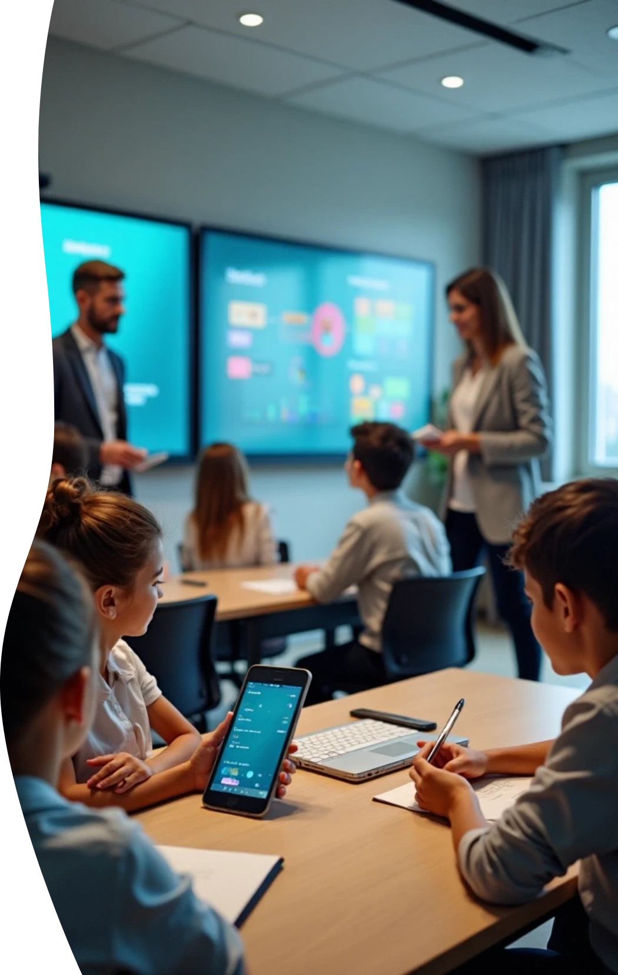
The Vision
Imagine a classroom where:
The system senses when you’re distracted or frustrated.
Lessons adapt instantly to your cognitive state.
Teachers get insights into students’ engagement and attention span.
This is NeuroAdaptive Learning.

Slide 4
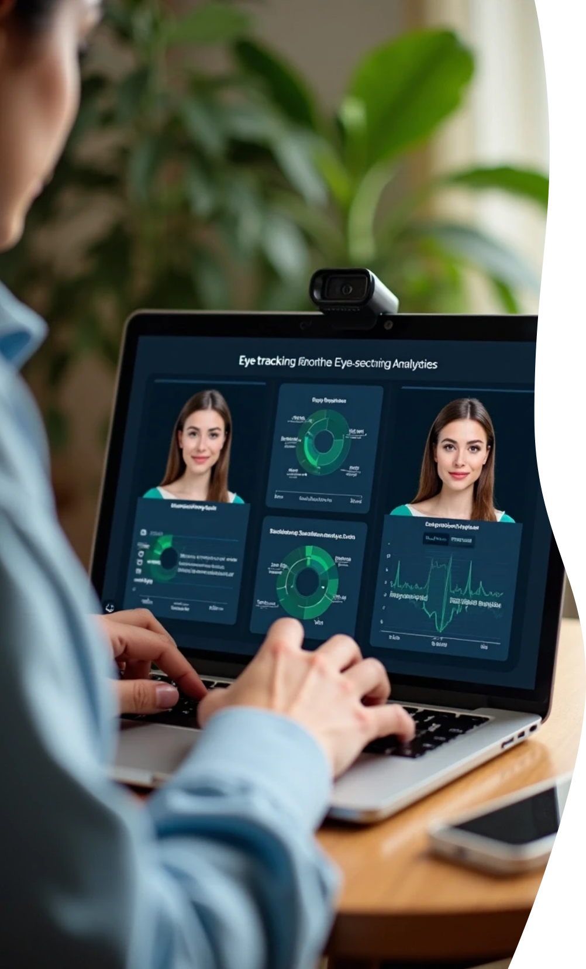
How It Works
(Core Components)
Data Capture:
Computer vision → tracks eye focus, facial expressions.
Voice sentiment analysis → detects stress, curiosity, frustration.
Cognitive Profiling:
Lightweight psychometric modeling builds unique learner profiles.
Adaptive Content Delivery:
Adjusts pace, modality (text → video → interactive),
gamification on the fly.

Slide 5

Real-Time Adaptation
Examples
If attention drops → switch to visual animations.
If frustration rises → lesson slows or offers step-by-step hints.
If overly easy → unlocks next-level challenges.
If highly engaged → introduces gamified rewards.

Slide 6
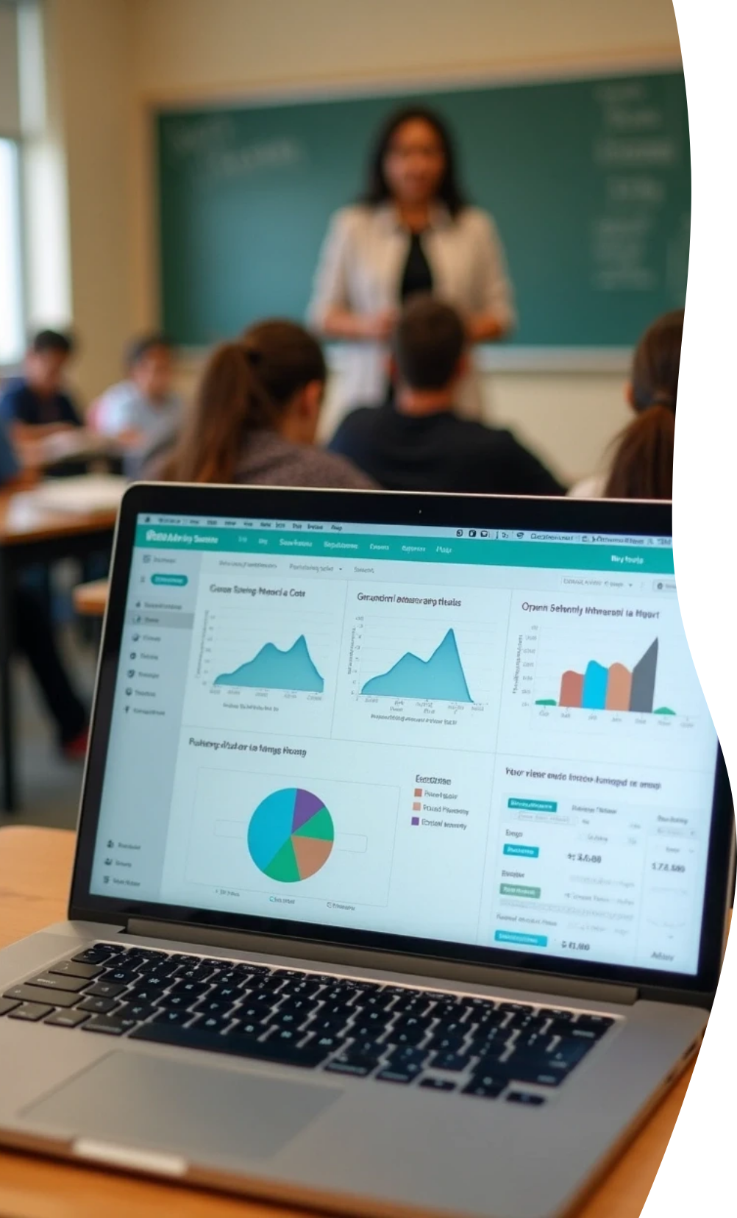
Teacher Dashboard:
Bonus Features
Class-wide trends in focus/stress.
Suggests interventions.
(group discussion, break time, peer help).
Offline Mode:
Edge AI for low-resource schools without full internet.
Gamified Feedback Loop:
Students earn “focus points” to unlock adaptive
mini-games/challenges.

Slide 7
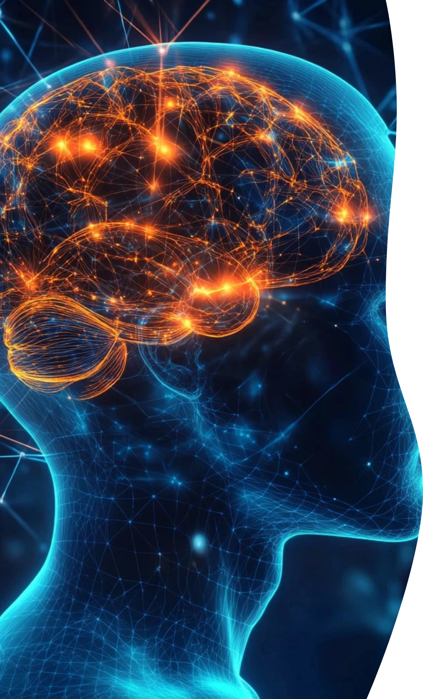
Neuroscience + AI Edge
Based on cognitive load theory &
emotional intelligence research.
Aligns with brain-based learning principles.
AI provides dynamic, data-driven personalization
unlike static e-learning.

Slide 8

Impact & Scalability
For Schools: Boosts student engagement, reduces dropout.
For Neurodivergent Learners: Tailored pathways improving inclusivity
For EdTech Platforms: Next-gen intelligent tutoring integration
Scalable:
From classrooms → mobile apps → global low-resource contexts.

Slide 9
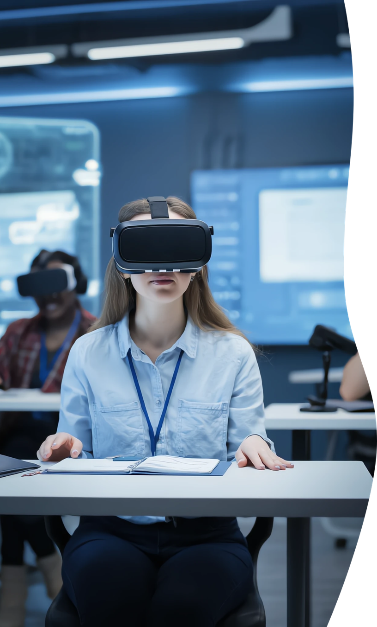
Example Use Cases
Classroom Setting: Teacher monitors engagement
dips to intervene.
Self-Learning Students: Adaptive AI tutor adjusts
to their study style.
Corporate Training: Employees get optimized
micro-learning sessions.
Special Education: Personalized sensory-friendly
learning pathways.

Slide 10
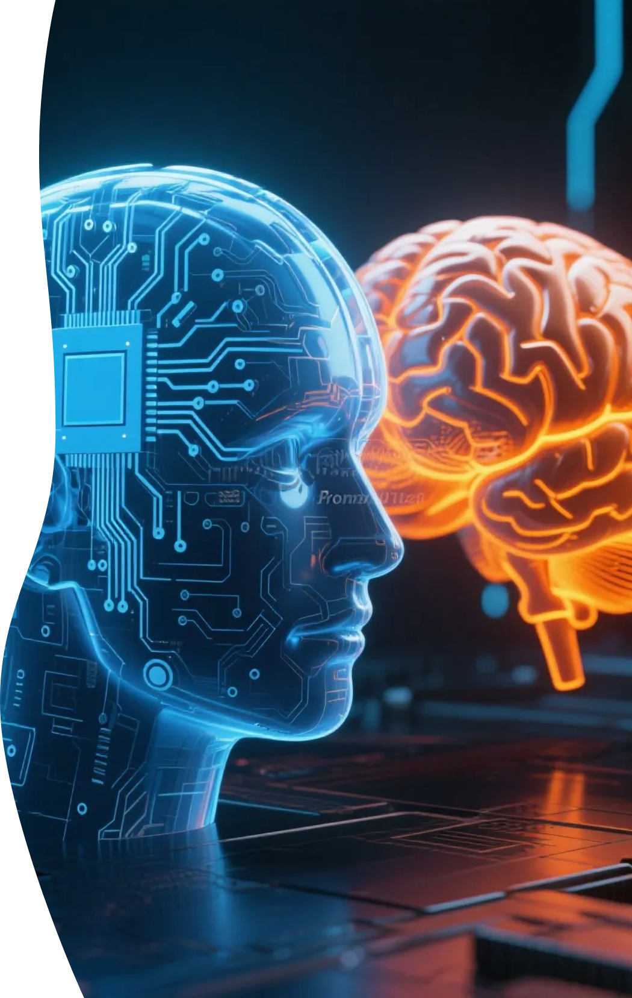
Closing & Vision
Statement
“Education shouldn’t just be personalized—it should
be neuroadaptive.”
A future where every mind learns differently, yet thrives equally
NeuroAdaptive Learning = The bridge between neuroscience,
AI, and education.

